Slide 1

Introduction to AI(AI101B) Even Semester Session 2024-25
HealthCare Data Cleaning
Team Leader: Mradul Tyagi (2410116100125)
Member: Gargi Singh(2410116100072)
Member: Nainsi Jain(2410116100128)
Project Supervisor:
Mr. Apoorv Jain
Assistant Professor

Slide 2
Introduction
The healthcare industry generates vast amounts of data daily, including patient records, medical histories, and test results.
Raw healthcare data often contains missing values, duplicates, and outliers, which can negatively impact analysis and predictive models.
Data cleaning is a crucial step to ensure the accuracy, consistency, and reliability of healthcare data.
This project focuses on preprocessing, normalizing, and engineering features to enhance data quality for better insights and decision-making.
By implementing effective data cleaning techniques, we can improve healthcare analytics, patient care, and predictive modeling accuracy.
Notes:
Font Styles: Times New Roman + Font Size: 25

Slide 3
Objective of the Project
Objectives
Data Cleaning & Preprocessing
Ensure high-quality healthcare data for analysis.
Handling Data Issues
Address missing values, outliers, and duplicates.
Feature Engineering
Feature Selection
Normalize and create new features for better model accuracy.
Identify the most relevant features for predictive modeling.
Notes:
Font Styles: Times New Roman + Font Size: 25

Slide 4

Methodology
Data Collection
Healthcare dataset with Patient ID, Age, Blood Pressure, Sugar Level, and Weight.
Loaded and explored for structure and column details.
Data Preprocessing
Missing Values:
Numerical: Filled with mean.
Categorical: Filled with mode.
Duplicates Removed to maintain data integrity.
Outlier Handling:
IQR Method applied to cap extreme values.
Data Normalization:
Standard Scaler used to bring values to the same scale.

Slide 5

Methodology
Methodology
Feature Engineering
Age Groups: Young, Middle-aged, Senior.
Feature Interaction: BP Sugar Interaction
(Blood Pressure × Sugar Level).
Categorical Encoding: Sugar Level categorized into Low, Normal, High.
Exploratory Data Analysis (EDA)
Visualizations:
Histograms & Boxplots for data distribution.
Scatter Plots to observe trends.
Correlation Analysis:
Heatmap to identify relationships between features.

Slide 6
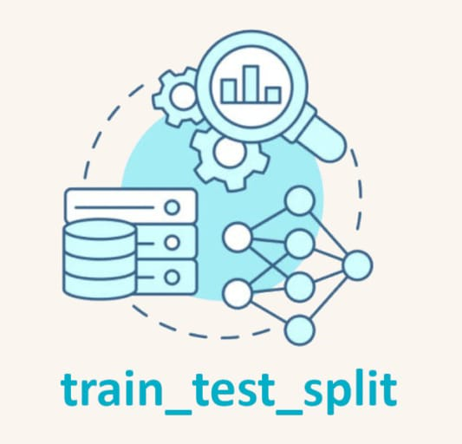
Methodology
Feature Selection
Select K Best (ANOVA F-test) selects top 5 features:
Age
Blood Pressure
Weight
BP Sugar Interaction
Sugar Level Category High
Data Splitting
Train-Test Split: 80% training, 20% testing.
Target variable: Converted into High Risk vs. Low Risk classification.

Slide 7
Techniques Used
Interquartile Range (IQR) for Outlier Handling
Detects and caps extreme values.
Prevents outliers from skewing results.
Standard Scaler for Data Normalization
Brings all features to a common scale (mean = 0, std = 1).
Ensures fair contribution of all numerical variables.
Select K Best (ANOVA F-test) for Feature Selection
Selects the most important features for modeling.
Improves model accuracy and reduces noise.
Notes:
Font Styles: Times New Roman + Font Size: 25

Slide 8
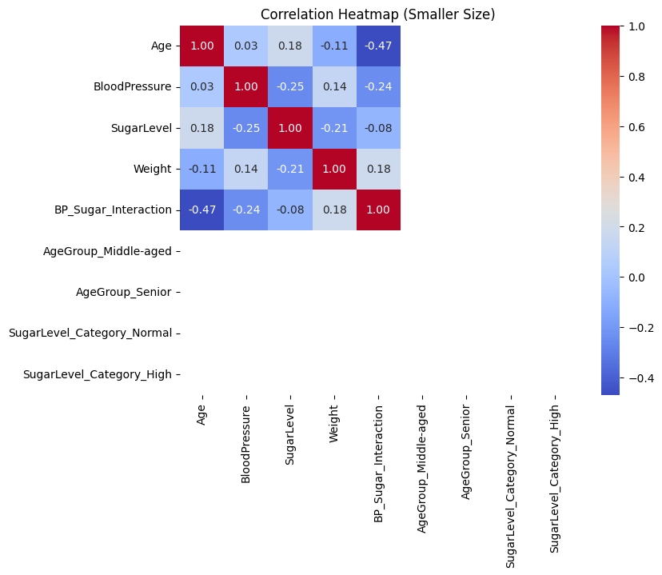
Results & Analysis
The heatmap shows relationships between healthcare parameters.
Key Insights:
Age & BP Sugar Interaction (-0.47): Moderate negative correlation.
Blood Pressure & Sugar Level (-0.25): Weak inverse relation.
Weight & Sugar Level (-0.21): Slight negative impact.
BP Sugar Interaction & Weight (0.18): Low positive correlation.

Slide 9
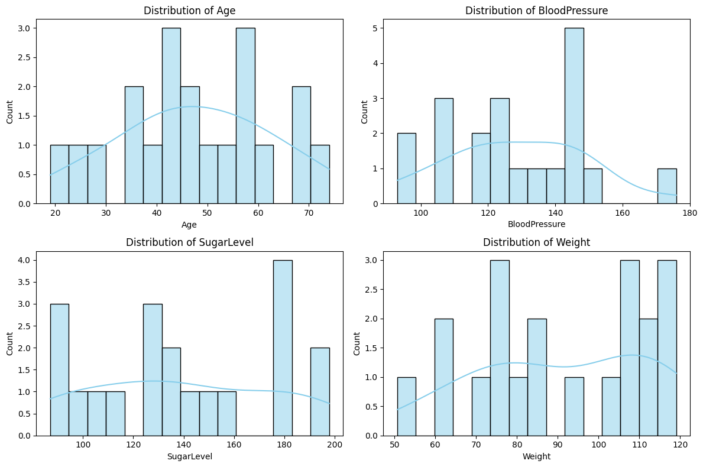
Results & Analysis
The histograms represent the distribution of Age, Blood Pressure, Sugar Level, and Weight in the dataset.

Slide 10
Conclusion
Successful Data Cleaning – The project effectively handled missing values, outliers, and duplicates, ensuring a high-quality dataset.
Enhanced Data Quality – Feature engineering and selection helped refine the dataset, making it more meaningful and structured.
Optimized for Machine Learning – The cleaned data is now ready for predictive modeling, improving accuracy and reliability in healthcare analytics.
Scalability & Future Use – The methodologies used can be applied to larger and more complex healthcare datasets, enhancing decision-making in medical analysis.
Impact in Healthcare – The processed data can assist in patient risk prediction, trend analysis, and data-driven medical insights.

Slide 11
THANK YOU!

